Slide 1
Introduction to Machine Learning and data science
Presentation to Strauss BI team

Slide 2




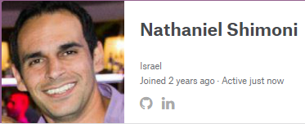
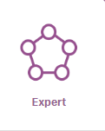
First a little bit about myself…
Married to Yonit & father of 2 great daughters Yahav & Arbel
Forecasting manager @ Strauss-FritoLay
I work for Strauss-FritoLay for the last 8.5 years
(operations controller in my previous position)
I’m a data scientist @ Kaggle.com
(currently ranked 345 of over 585,000 competitors)

Slide 3


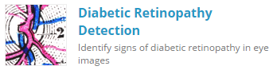






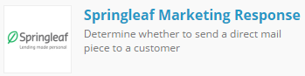
A little more about that Kaggle thing…
Kaggle.com is the biggest online community for data science competitions & sharing worldwide
It deals with ability to answer business questions through data:

Slide 4
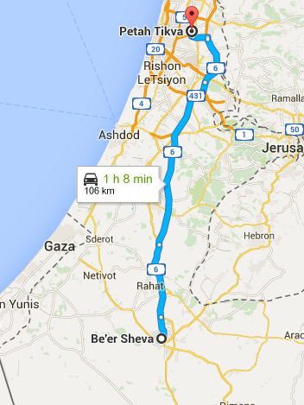




How did I get here?
Daily driving 230km I searched for prolific way to pass time
Began listening to lectures along the way
Got fascinated by Data Science courses

Slide 5
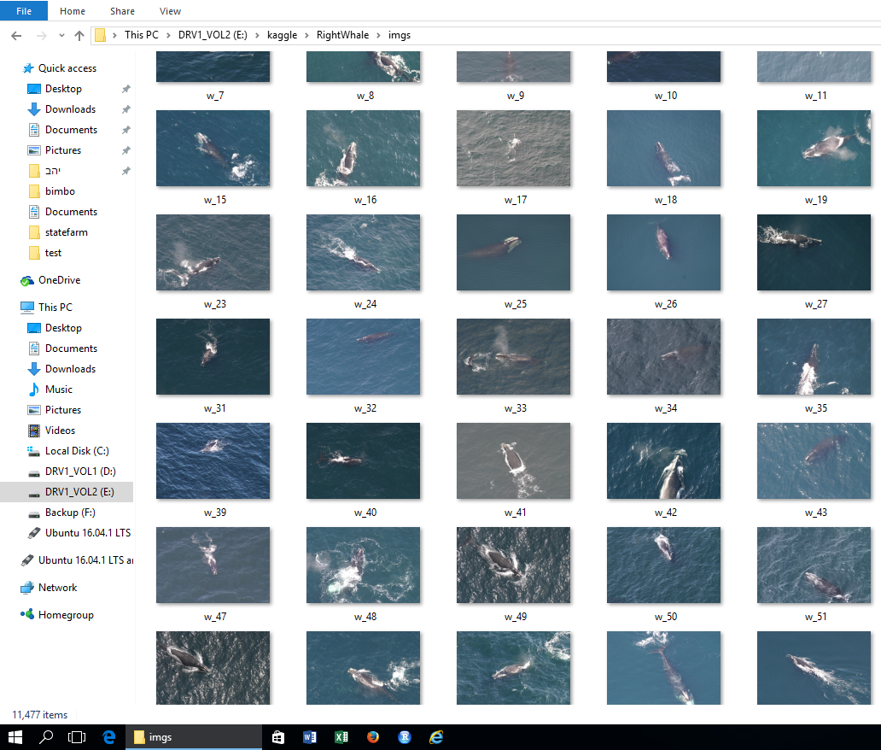
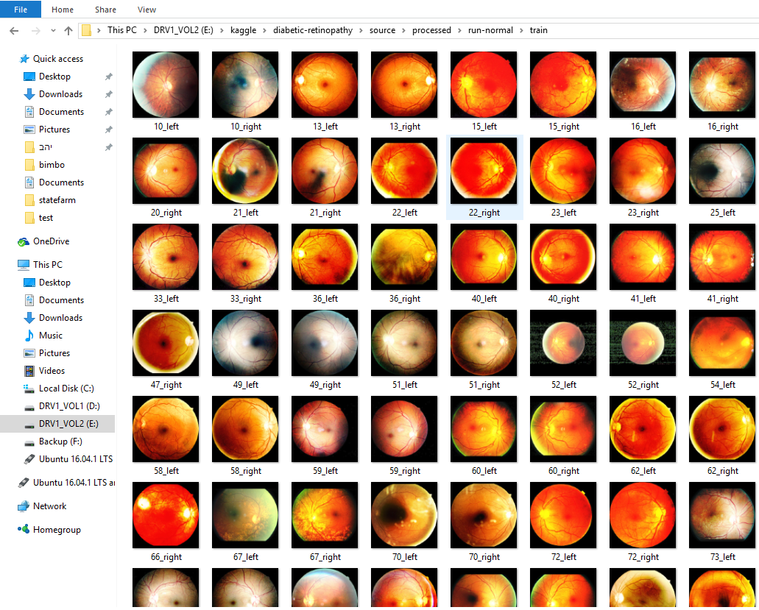
Sometimes what I’m doing seems odd

Slide 6
Machine learning
Who heard of machine learning before?
Who implemented machine learning before?
Who used machine learning before?
As we will see, we all use machine learning algorithms every day !

Slide 7
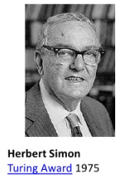
What is Machine learning?
Learning is any process of improving performance
by experience (Herbert Alexander Simon).
Machine Learning -> computer programs that automatically improve their performance through experience (data / user interaction)
Machine learning is a sub field within Artificial Intelligence

Slide 8
Why do we need it ?

Slide 9
availability
Cost efficiency
Scalability
Machine learning
benefits
Less biased
accuracy
consistency
Response time

Slide 10
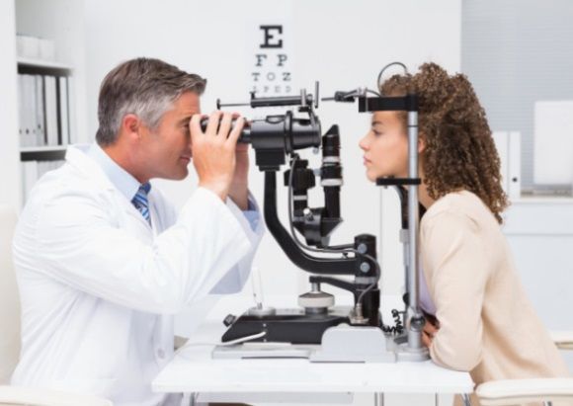
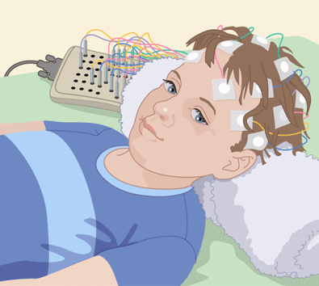
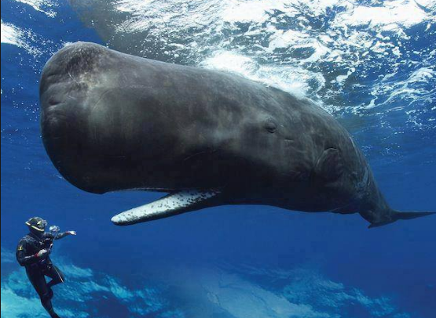
How long does it take to be expert?
Rule of thumb -> 10,000 Hours
Which is roughly 7 years of progressive work !

Slide 11
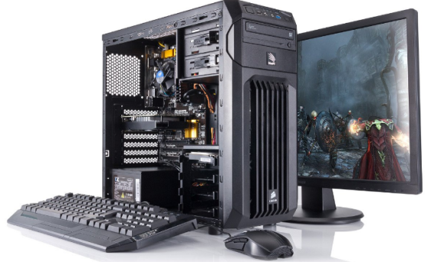
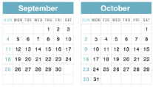
How long does it take to be expert?
But what if we could gain “experience in parallel”?
remember those eyeball or whales images?
Home (gaming) hardware
Few weeks training
+
+ Data + ML
=
Competitive accuracy to that of the experts

Slide 12
Types of
machine learning

Slide 13
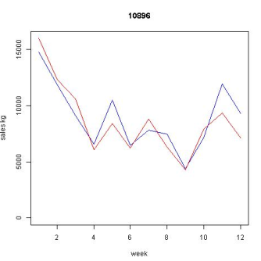
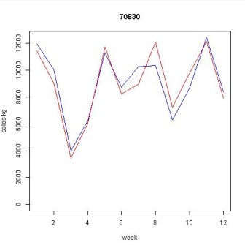
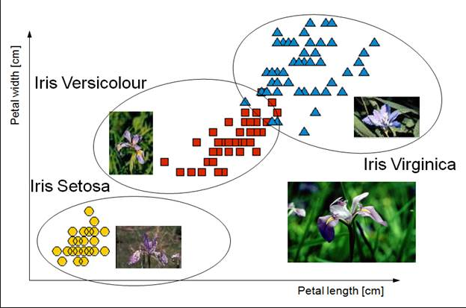
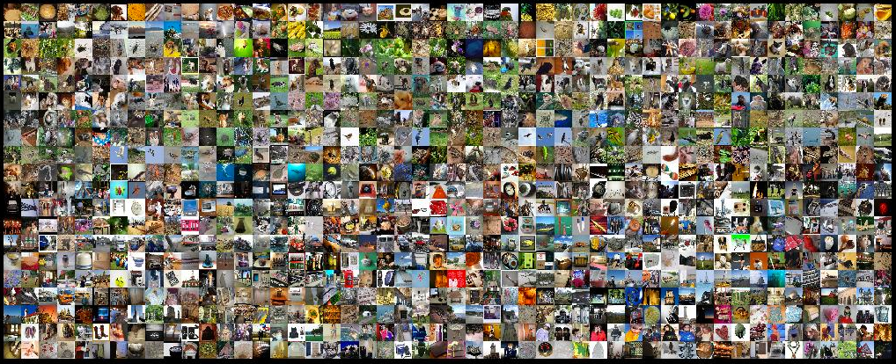
Types of Learning
Supervised learning
The data has labels = the target for past data is known
Sales prediction
Image-net dataset large scale classification
Iris dataset - classification

Slide 14
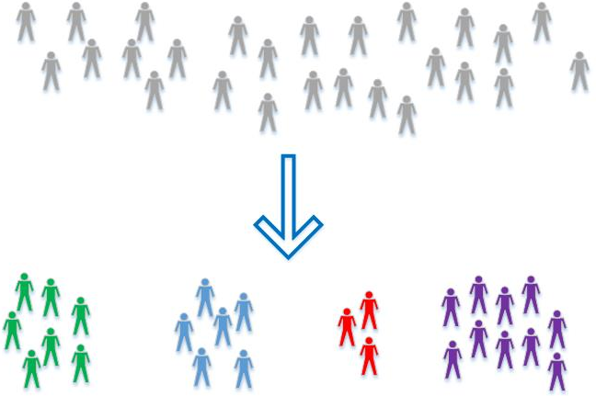
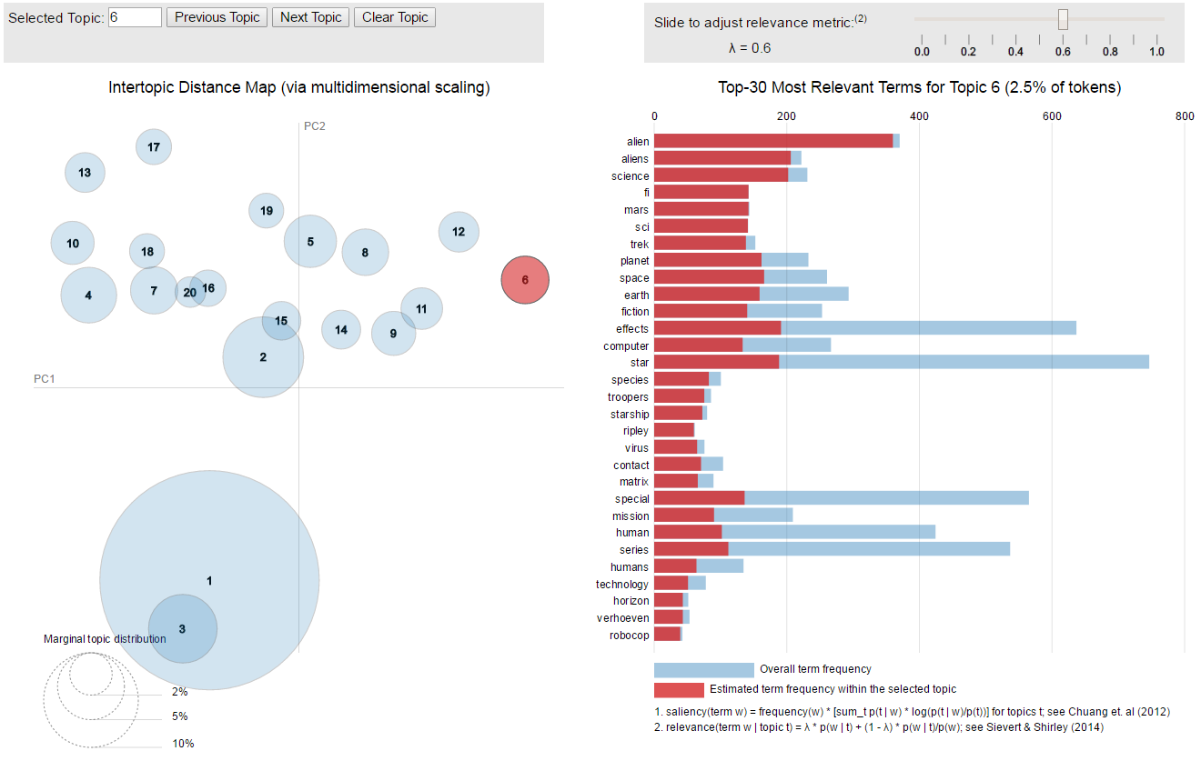
Types of Learning
Unsupervised learning
The idea is to extract insights about the data:
(segmentation, common behavior, common features)

Slide 15
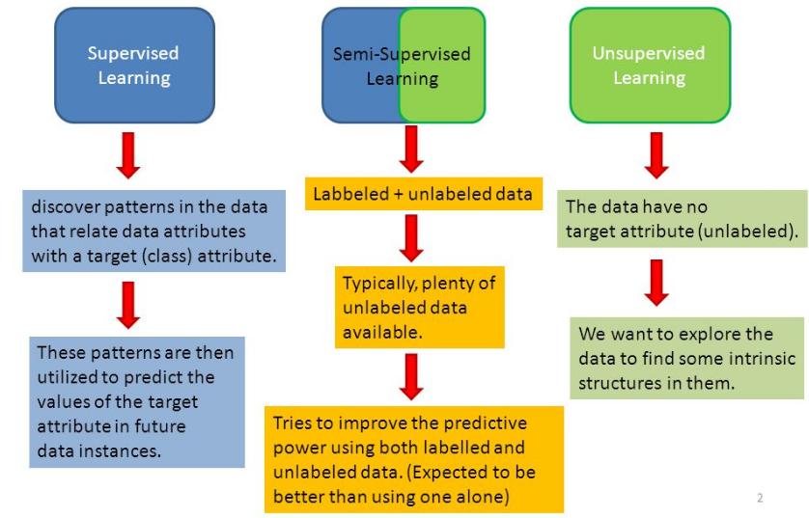
Types of Learning
Semi-supervised learning
Hybrid approach:
Since most of available data is unlabeled can we improve by using lots of unlabeled data with small amount of labeled data

Slide 16
Applications of
machine learning

Slide 17

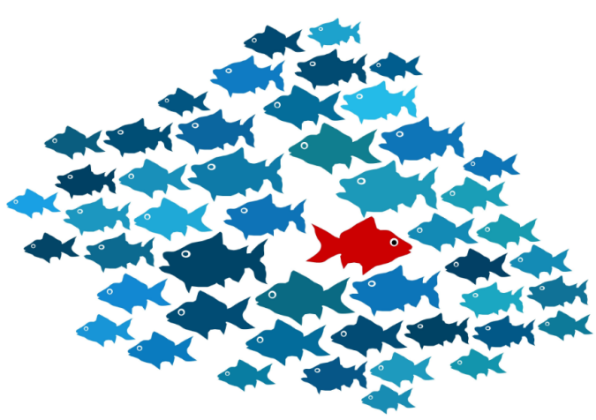

Example applications of ML
Classification models:
Classifying costumers (good/bad payers, satisfied/dissatisfied etc.)
Classifying transactions (fraud detection, spam/virus, sentiment)
Notes:
לקשר ל-BI ככל האפשר

Slide 18
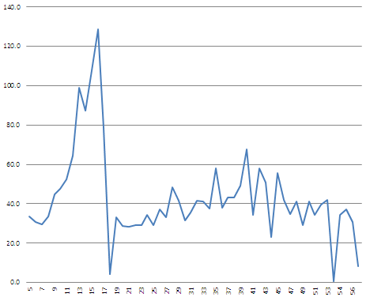


Example applications of ML
Regression models:
Sales planning (AOP, inventory planning, manning)
On a second thought I don’t need that many…
I need every man you can get me
Notes:
לקשר ל-BI ככל האפשר

Slide 19
Example applications of ML
Clustering models:
Dimensionality reduction (selection of most relevant attributes)
Compression (like zip files)
Categorization
Representation (like in text analytics)
Man
Woman
King – Man + Woman = Queen
King
Queen
Notes:
לקשר ל-BI ככל האפשר

Slide 20

Example applications of ML
Anomaly detection:
Detecting outliers / inliers
Detecting “strange” combinations
Alert base systems
Oh I used the wrong unit in the order
30K$ on stickers ???
Notes:
לקשר ל-BI ככל האפשר

Slide 21
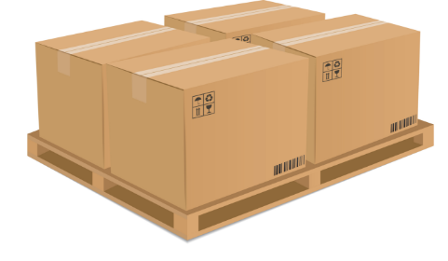
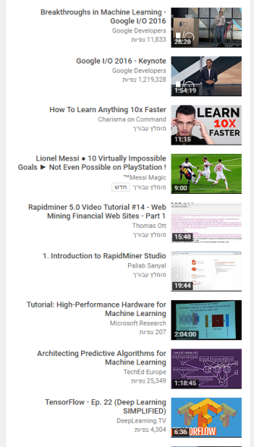
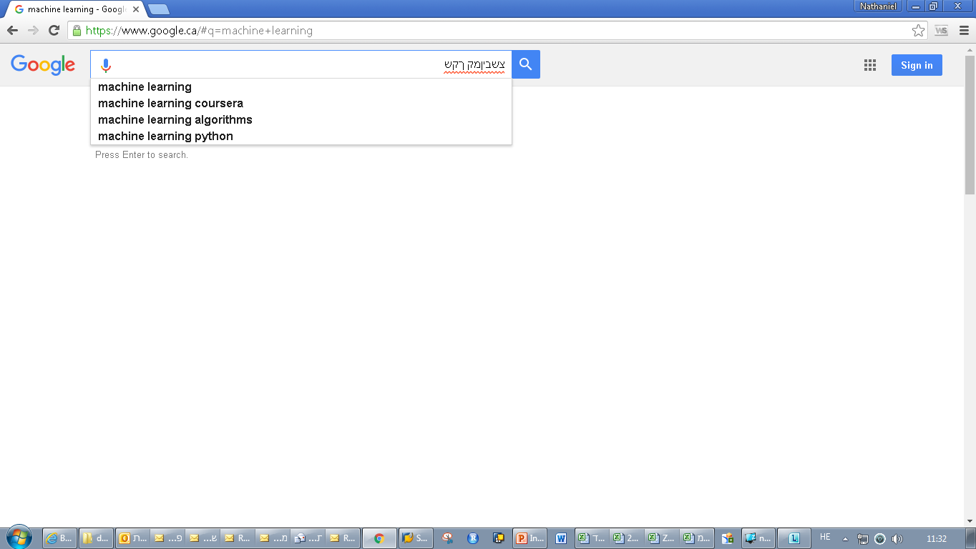
Example applications of ML
Collaborative filtering:
Recommender systems
Text autocompleting
To avoid Out Of Stock order at least 4 cases!
Users like you also watched:
Notes:
לקשר ל-BI ככל האפשר

Slide 22
Basic stages of ML process
Getting data
Pre - processing
Splitting
Modeling
Validating
Testing
Desired data is not always the data we have
Add external data
Data exploration
Data structure
Remove NA
Remove outliers
Use relevant transform.
Train
Validation
Test
How will we know it’s a good model
Train
relevant
model (s)
Checking trained model predictions on new data
Tuning parameters by validation results
Ensambling
Evaluate
final
model
before
“go live”

Slide 23
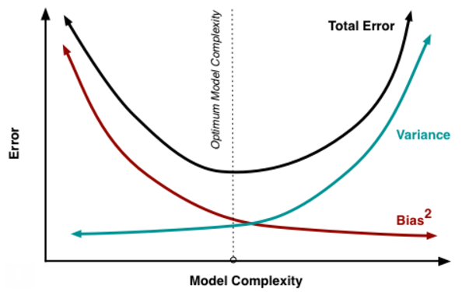

Why do we need to split?
Input data
train
Trained
Model(s)
Well…
If you tell me what has happened –
I can definably predict it !
Trained
Model(s)
+
Validation data
Tuned parameters
And model performance
validate
tuned
Model(s)
+
Test data
Well performing model(s)
test

Slide 24
Questions ?

Slide 25
Thank you
for listening
www.Github.com/nathanie
www.kaggle.com/interesting

Slide 26
Further reading & additional material
Machine learning – Coursera
Why economists make great data scientists?
Python Scikit-learn introduction – hands-on 3h lecture
Deep learning simplified YouTube channel
Data-science track Coursera
www.kaggle.com
http://www.kdnuggets.com/
http://www.image-net.org/challenges/LSVRC/

Slide 27
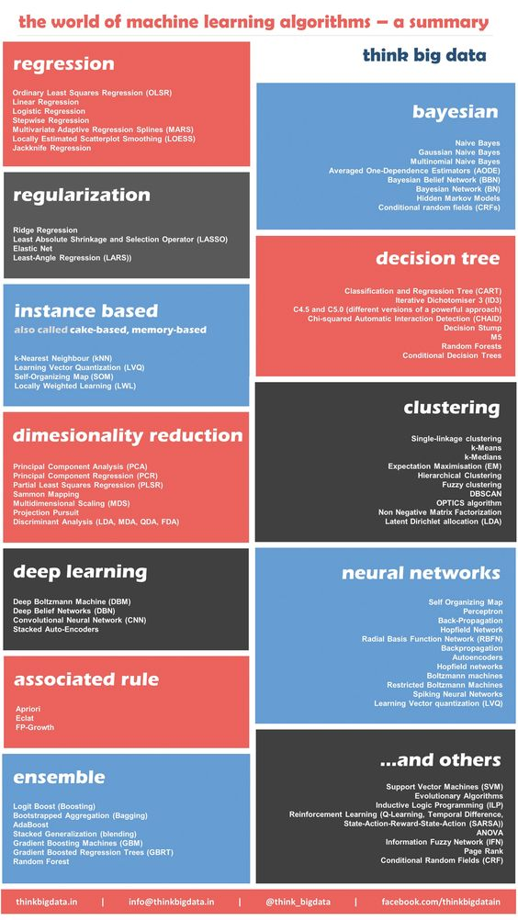
Most common algorithms in ML

